Slide 1

The change in marriage and divorce rates due to the pandemic in Turkey
Simge KAVALCI
17030411025
MIS

Slide 2
Introduction
Along with the restrictions imposed due to the Covid 19 virus, which affected the whole world, significant differences occurred between the marriage and divorce statistics of people for various reasons.
Marriage and divorce statistics for the years 2019-2020 were used to compare these differences.
In this research, we will consider these data with the graphs.
In this research, we will cover the following under the title of 2019 - 2020 marriage and divorce statistics;
Number of couples married in 2019 - 2020,
The number of couples divorced between 2019 and 2020,
Number of marriages by months (2019, 2020),
Number of divorces by months (2019, 2020),
10 provinces with the highest and lowest crude marriage rate, (2020)
10 provinces with the highest and lowest crude divorce rates, (2020)

Slide 3
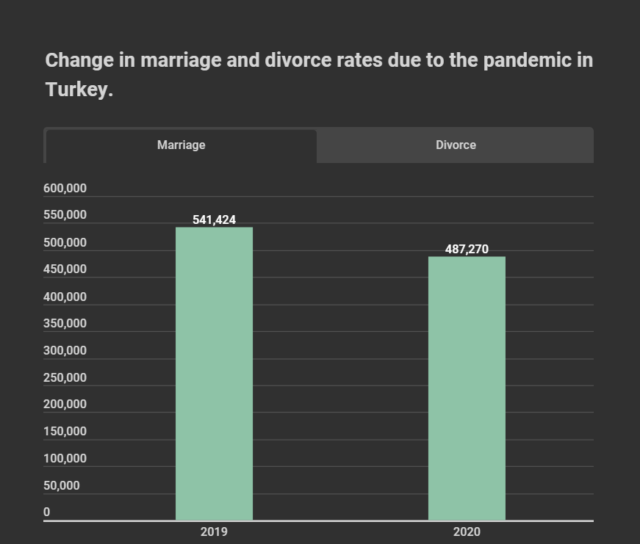

While the number of married couples was 542 thousand 314 in 2019, it decreased by 10.1% in 2020 to 487 thousand 270.
The reason for this decrease is said to be the restrictions imposed due to the pandemic (e.g. marriage offices are closed and wedding restrictions.)
Reference: https://data.tuik.gov.tr/

Slide 4
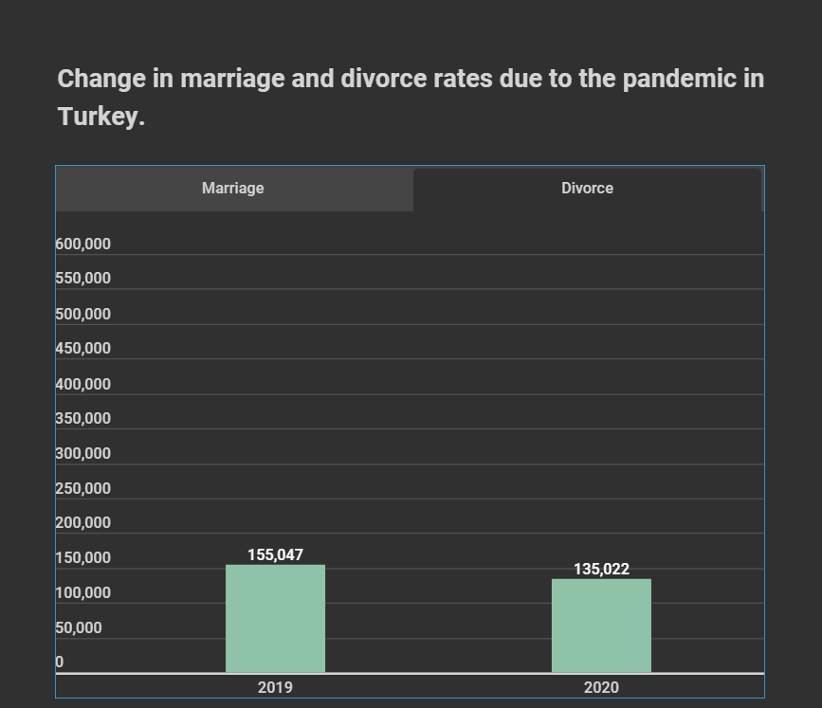

While the number of divorced couples was 156 thousand 587 in 2019, it decreased by 13.8% in 2020 to 135 thousand 22.
It is said that the reason for this decrease is the restrictions imposed due to the pandemic. (e.g. adjournment of cases)
Reference: https://data.tuik.gov.tr/

Slide 5
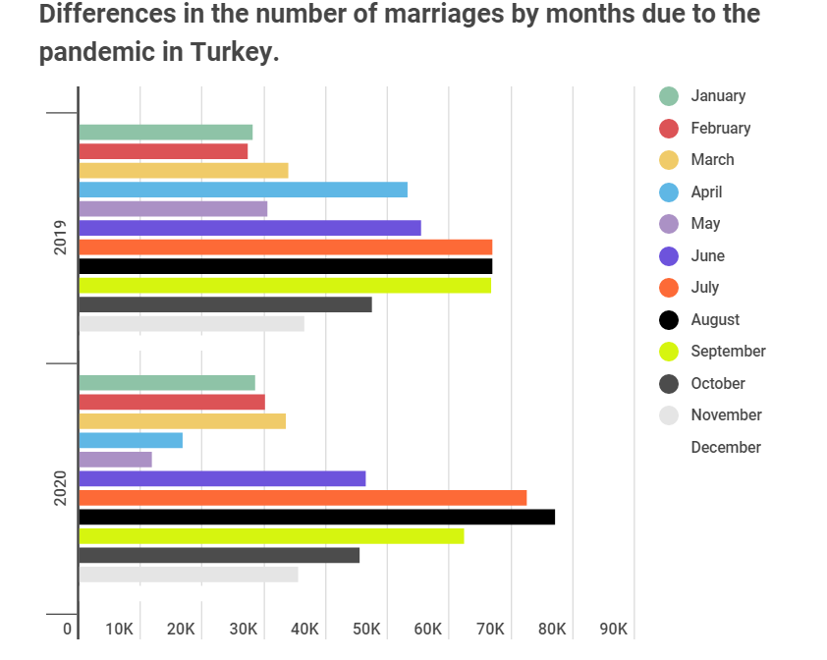
When the number of marriages is analyzed by months, a significant decrease was observed in April and May of 2020. While the number of marriages was 53 thousand 155 in April 2019, it decreased by 68.7% with the effect of the pandemic and became 16 thousand 657 in the same month of 2020. While the number of marriages in May 2019 was 30 thousand 376, it decreased by 61.6% and became 11 thousand 666 in the same month of 2020 with the effect of the pandemic.
On the other hand, the number of marriages increased in July and August of 2020 compared to the previous year. While the number of marriages was 66 thousand 932 in July 2019, it increased by 8.2% and became 72 thousand 402 in the same month of 2020. While the number of marriages was 66 thousand 987 in August 2019, it increased by 15.1% and became 77 thousand 86 in the same month of 2020.
Reference: https://data.tuik.gov.tr/

Slide 6
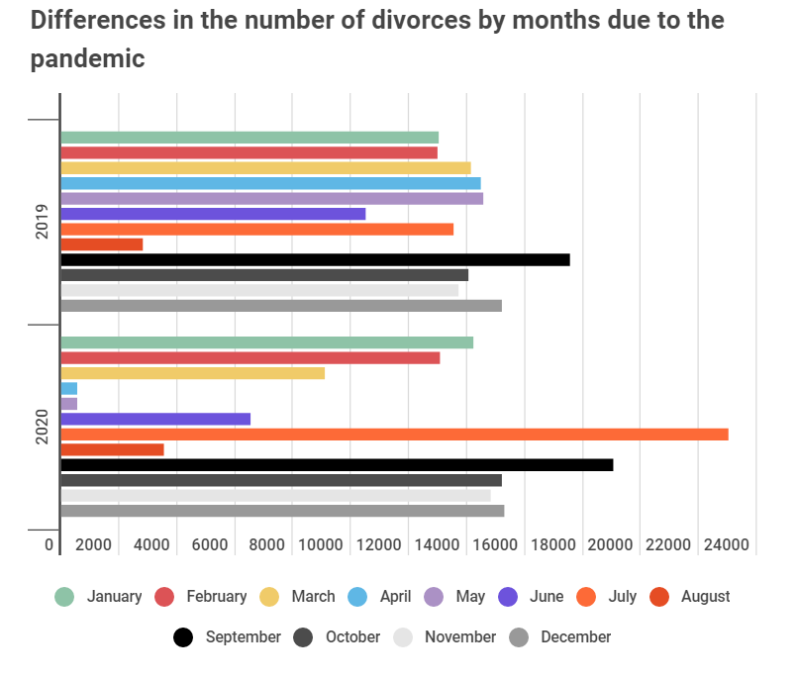
When the number of divorces is analyzed by months, a significant decrease was observed in April and May of 2020 due to the pandemic. While the number of divorces was 14 thousand 496 in April 2019, it decreased by 96.1% to 562 in the same month of 2020, while it was 14 thousand 555 in May 2019 and decreased by 96.2% to 548 in the same month of 2020. On the other hand, the number of divorces increased in July 2020 compared to the previous year. While the number of divorces was 13 thousand 555 in July 2019, it increased by 69.9% to 23 thousand 25 in the same month of 2020.
On the other hand, it was seen that the number of divorces decreased in August of 2019 and 2020 due to the judicial holiday.
Reference: https://data.tuik.gov.tr/

Slide 7
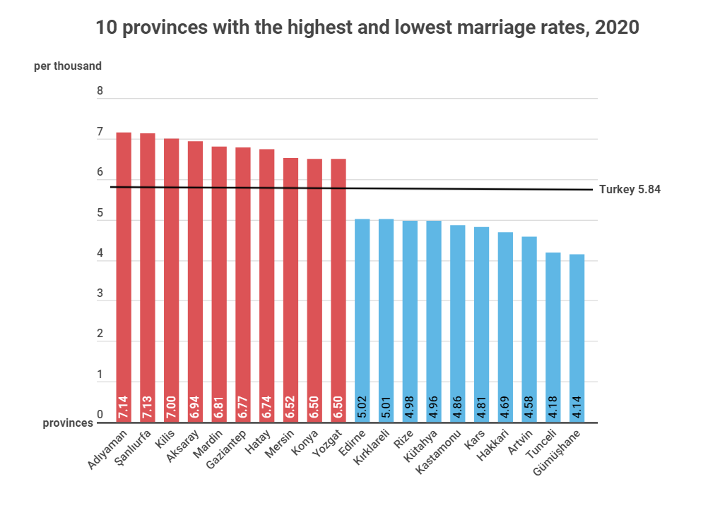
The province with the highest crude marriage rate was Adıyaman with 7.14 per thousand.
The province with the highest crude marriage rate in 2020 was Adıyaman with 7.14 per thousand. This province was followed by Şanlıurfa with 7.13 per thousand and Kilis with 7.00 per thousand. The province with the lowest crude marriage rate was Gümüşhane with 4.14 per thousand. This province was followed by Tunceli with 4.18 per thousand and Artvin with 4.58 per thousand.
Reference: https://data.tuik.gov.tr/

Slide 8
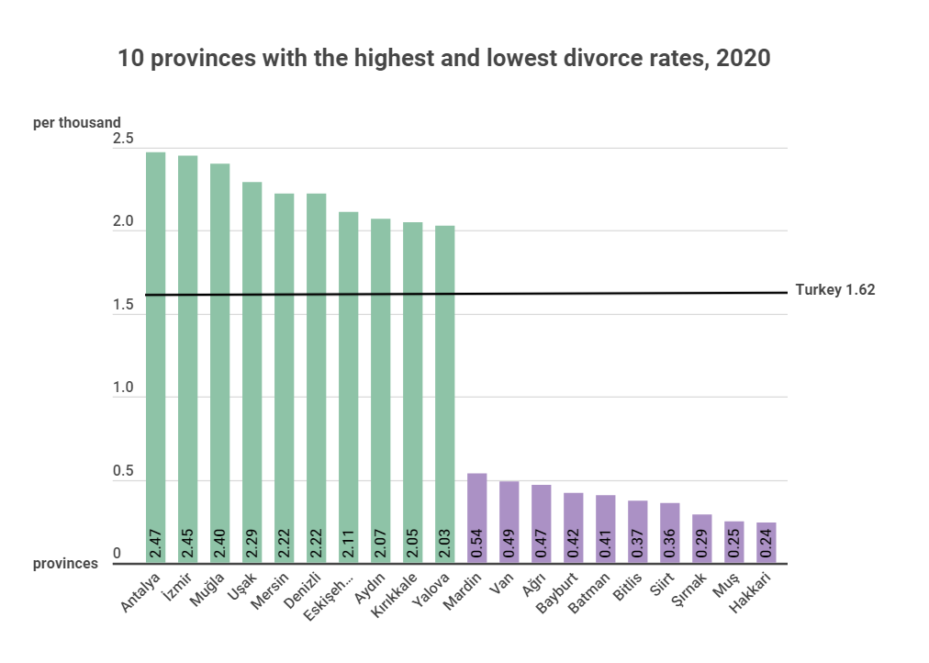
The province with the highest crude divorce rate was Antalya with 2.47 per thousand.
The province with the highest crude divorce rate in 2020 was Antalya with 2.47 per thousand. This province was followed by İzmir with 2.45 per thousand and Muğla with 2.40 per thousand. The province with the lowest crude divorce rate was Hakkari with 0.24 per thousand. This province was followed by Muş with 0.25 per thousand and Şırnak with 0.29 per thousand.
Reference: https://data.tuik.gov.tr/

Slide 9
RESULT
As a result of this research, there was a decrease in the number of marriages and divorces due to the pandemic. As I said before, the closure of the wedding offices, marriage restrictions and postponement of the lawsuits have an important role among the reasons for this decline.
In addition, couples spending more time with each other due to the curfew, seeing each other's shortcomings as a result, and the bad effect of the pandemic on human psychology can be added as the reason for the increase in divorce.
The fact that couples do not want to marry because they want to have a wedding without restrictions during the pandemic may be among the reasons for the decrease in the marriage rate.

